Slide 1









“Redbus Data Scraping & Dynamic Filtering using Streamlit”

Slide 2




TABLE OF CONTENTS
01
02
03
PROBLEM STATEMENT
OBJECTIVE
WHAT I DID

Slide 3






Problem Statement
Manual comparison of buses across multiple states on Redbus is tedious. There’s no centralized dashboard to filter or analyze pricing, seat availability, or types.

Slide 4







Objective
Build a SQL- to store and query scraped data
Create an interactive dashboard using Streamlit for filtering
Atomate bus data collection from redbus

Slide 5

S
P
Q
S
SELENIUM
PYTHON
MySQL
STREAMLIT
Data scraping via Selenium
Import required libraries for data cleaning and formatting
Data stored in SQL and Filters using SQL queries
Dashboard built using Streamlit

Slide 6




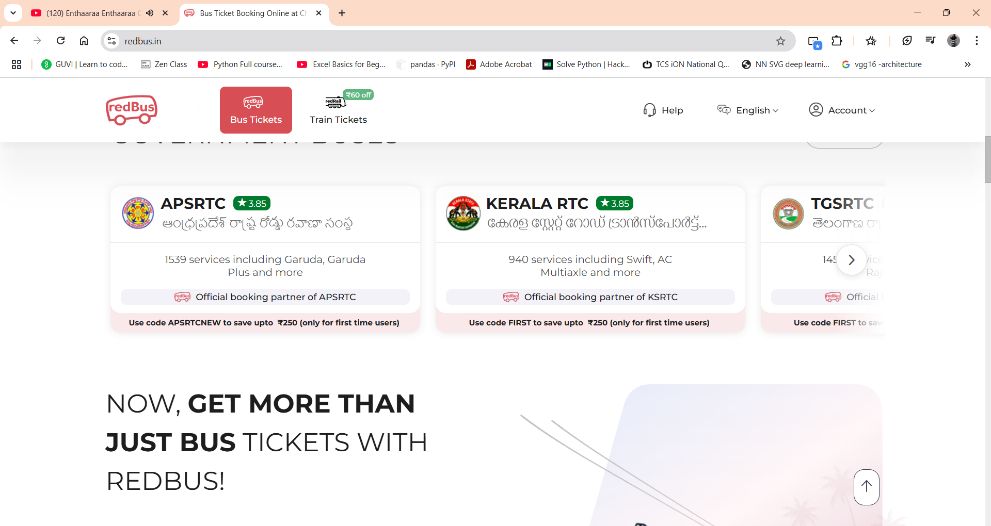


Data Collection
01
Selenium for data collection
10 States covered
Fields scraped [bus route, links, name , from, to , type, rating, seat availability, price, etc.]

Slide 7
Database Design & Storage
Created MySQL database to state structured bus data .
Designed relational tables: States, routes , buses, fares, availability.
Inserted scraped data using Python-MySQL-Connectror

Slide 8
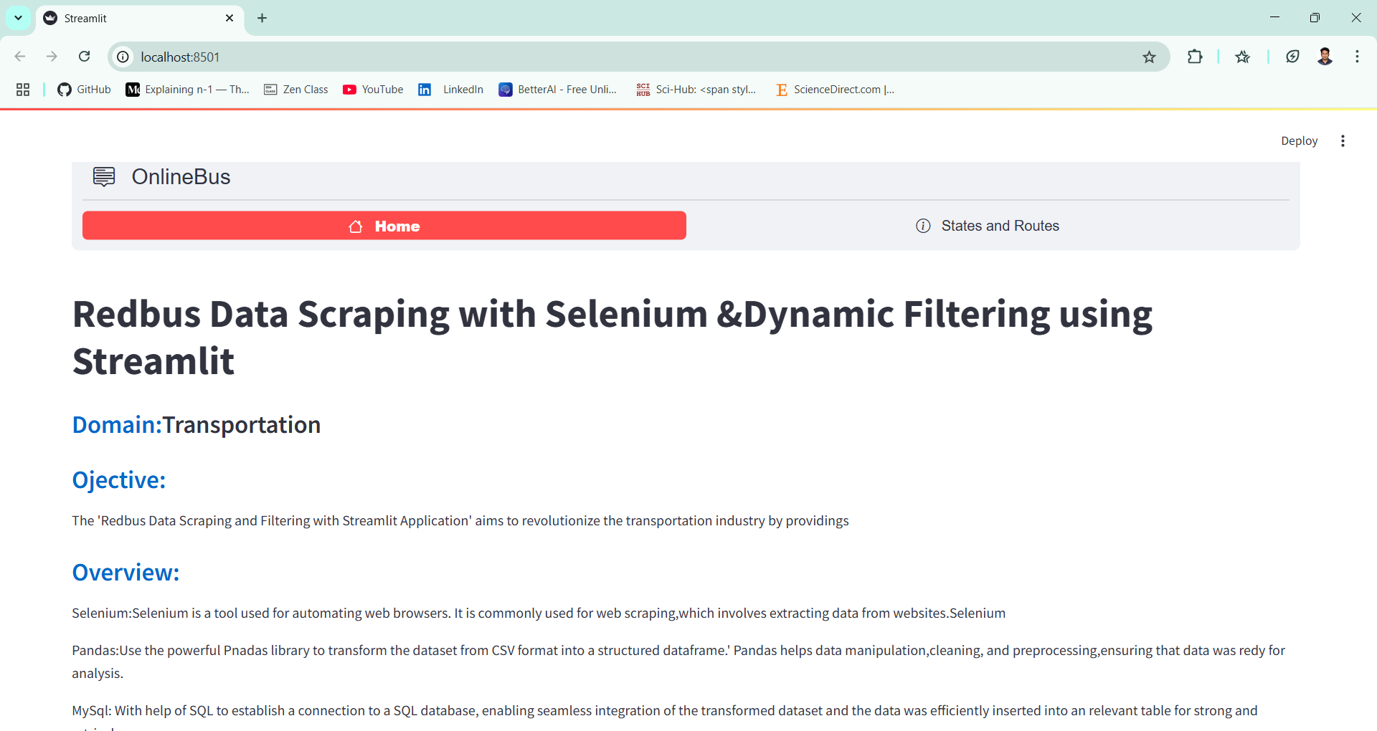
Streamlit Dashboard Development
Built an interactive dashboard using Streamlit .
Implemented filters for : State , Route, Price range , District.
Displayed results using tables.

Slide 9


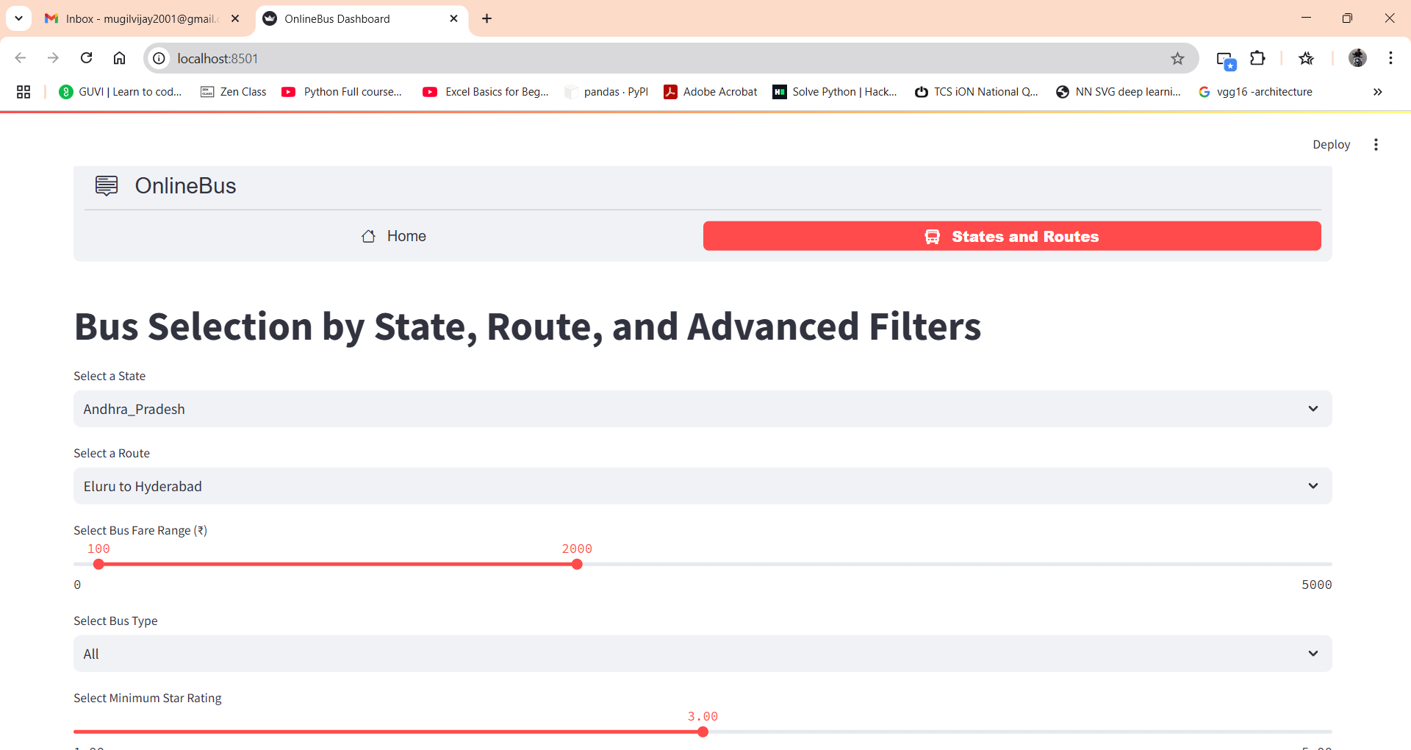


Streamlit dashboard

Slide 10
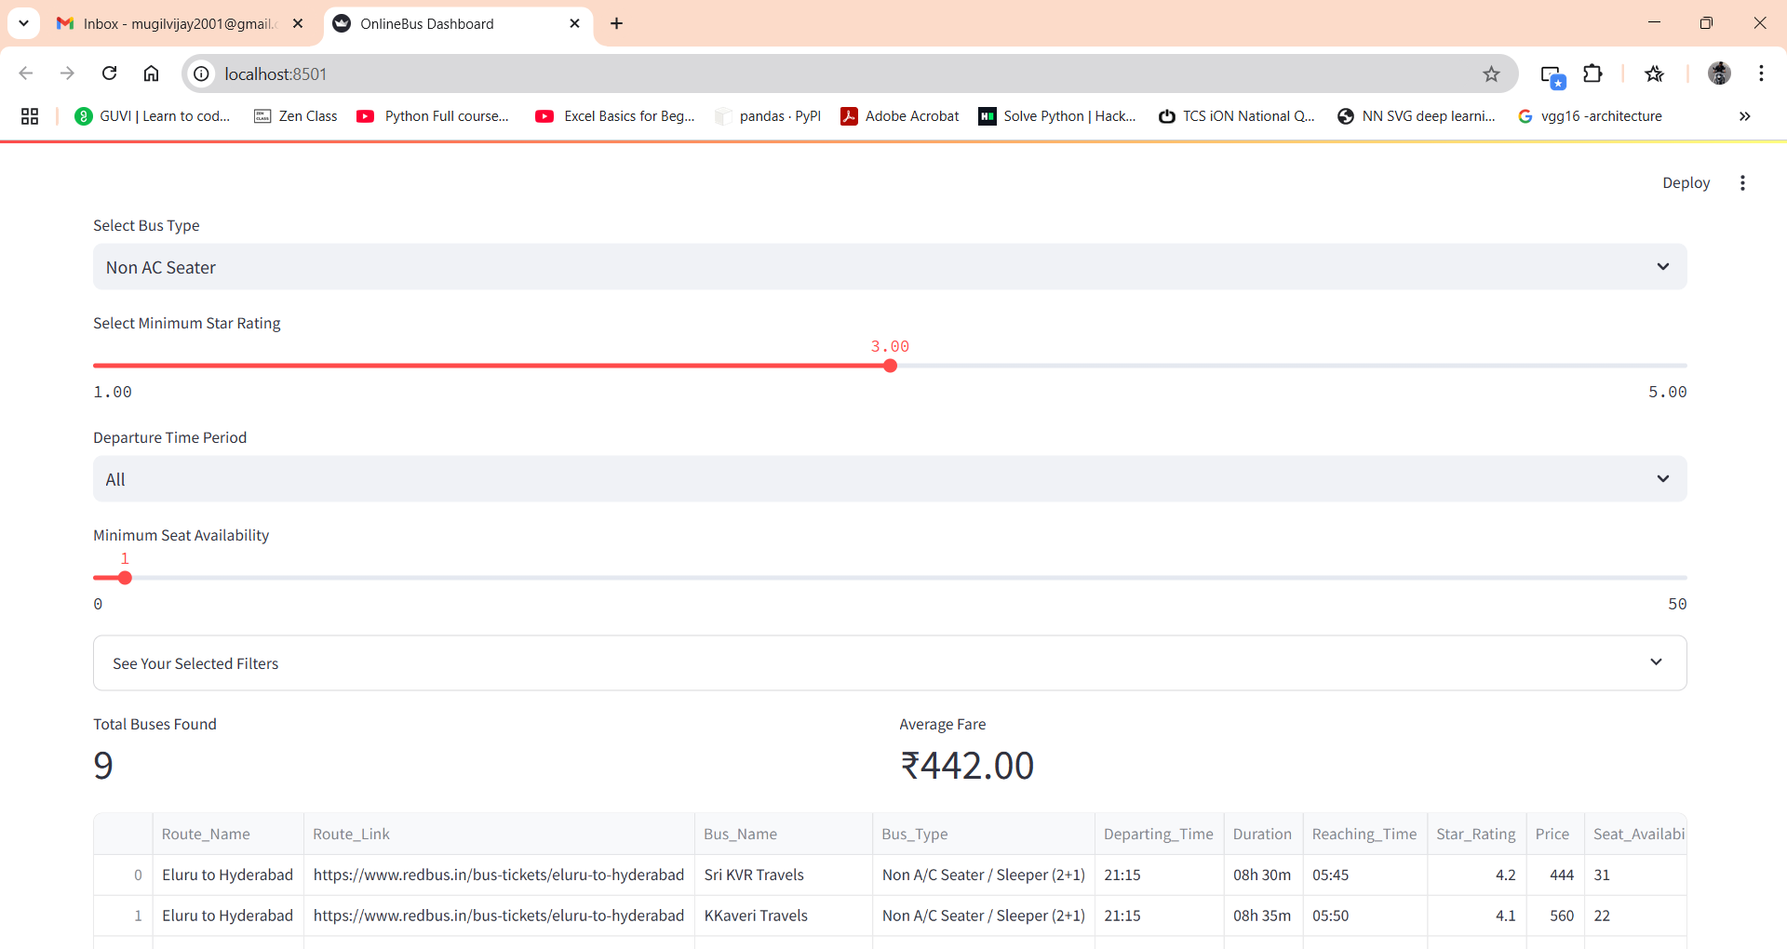
Bus type Selected

Slide 11
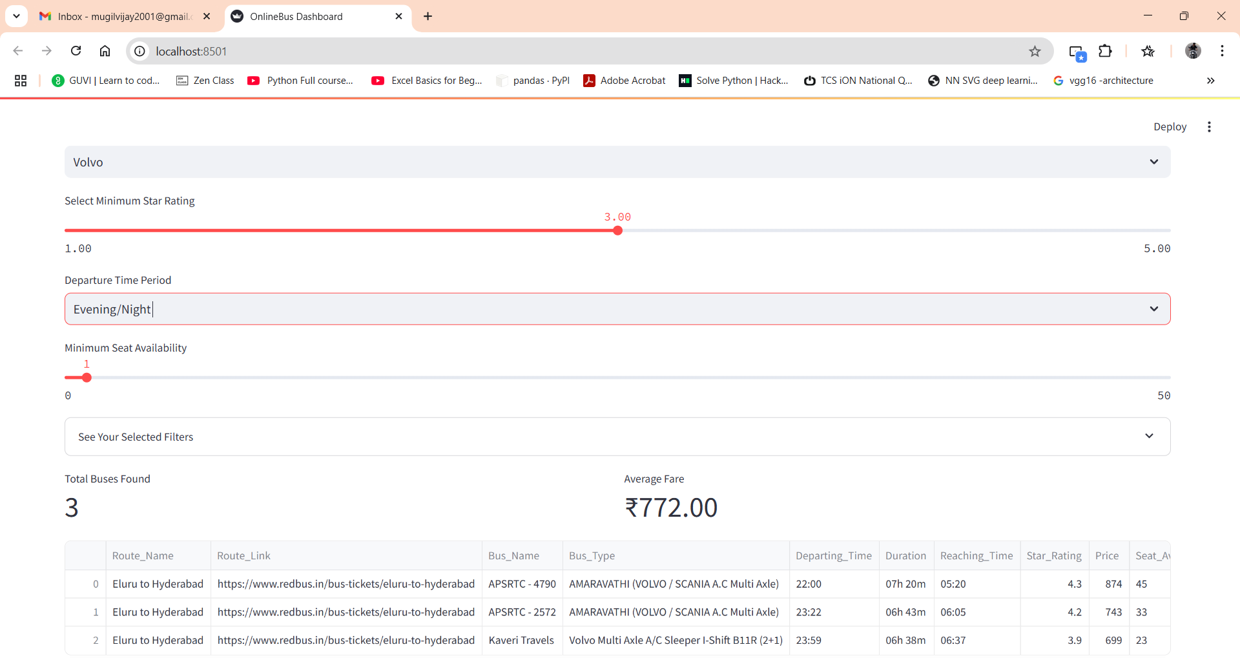
By using filter Departure time period

Slide 12
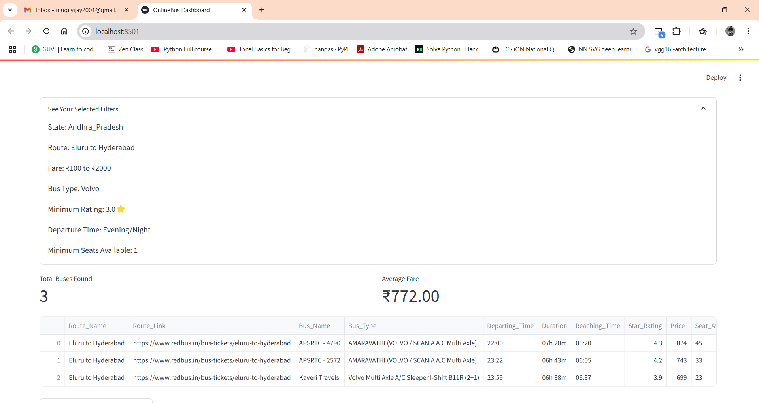
Filters which are selected

Slide 13
Business use cases & Future scope
Business Use Cases
List of applications:
Travel aggregators (real-time data)
Market research (fare trends)
Competitor analysis (pricing)
Customer experience personalization
Future Scope
Ideas to expand:
Real-time fare tracking
Price prediction using ML
Integration with Google Maps

Slide 14


THANK YOU

